Slide 1
Balancing Speed and Coverage by Sequential Seeding in Complex Networks
YUXIAO LI
SHENGZHE(HARRY) SUI
Instructor: Prof.Boleslaw K. Szymanski

Slide 2
BACKGROUND
Notes:
When we face complex problems that require a decision, it is always difficult for people to make one. However, we can separate the problem into multiple steps and make decisions partially, thus we can proceed by the consequences. Such a strategy is called the sequential approach and it is proved to be very helpful and efficient in several areas as well as choosing individuals called seeds that can be activated in a social network and spread information and opinions.

Slide 3
Sequential
Method
Separate the Problem into Multiple Steps and Make Decisions Partially

Slide 4
Sequential
Method
&
Network Diffusion
Max Coverage
v.s.
Speed

Slide 5
Influence Maximization &
information Spread
In Complex Networks
Single Stage Seeding

Slide 6
Factors Affecting the Diffusion and Social Influence
Ranking Influencers
Impact of Homophily
Heterogeneous Thresholds
Critical Initiator Fraction
Different Network Features

Slide 7
Seeding Strategies Application
Viral Marketing
Social Campaigns
Political Campaigns
Information Diffusion
Notes:
Typically, the seeding strategies are applied in viral marketing, social campaign, political campaign, diffusion of information, and so on. As in these areas, the seeds are assumed to be initiated at once that is to say there is no further support for the seed.

Slide 8
Seeding Selection
Strategy
Static Seeding
V.S.
Dynamic Seeding

Slide 9
Recent Research
Two-Stage Model:
Neighboring Nodes
After First-Stage:
Potential of Using Seeds
Delay-Tolerant Networks:
multi-period spraying algorithm
Not initiating a node that is likely to be activated by other seeds:
structural heuristics for seeds chossing

Slide 10
Sequential Seeding
Multiple Packages
Initiated Separately

Slide 11
Purpose of Research
Notes:
The paper discusses five methods of sequencial seeding and compares them to the single stage seeding method. To verify the performance of sequencial seeding, the paper tests the coverage and speed of each method with different network, ranking methods, propagation probabilities, seeding percentage and compare the results to those of SN obtained with same configuration.

Slide 12
Main Challenge:
Maximize The Final Spread
Coverage and Speed of Each Method
Different Network
Ranking Methods
Propagation
Probabilities
Seeding Percentage
Compare with single stage

Slide 13
METHODS
SQ_kPS
SQ_TSN
SQ_kPS_R
SQ_TSN_R
SQ_kPS_B
v.s. SN

Slide 14
METHODS
Ranking Method:
random selection
node degree
second level degree (node degree + neighbors’ degree)
page rank
eigenvector

Slide 15
METHODS
Diffusion: Independent Cascade Model

Slide 16
METHODS
Max Coverage:
Coverage when reach max saturation
Time:
unit time: 1 step of diffusion
time = # diffusion steps
Notes:
dynamic v.s. static

Slide 17
Single Stage Seeding (SN)
Process:
Rank the nodes
Select n top ranked nodes
Start diffusion
(without additional support)
# Total Nodes Used | n
# Seeding Stages | 1
Max Coverage | C_SN
# Steps / Time | T_SN

Slide 18
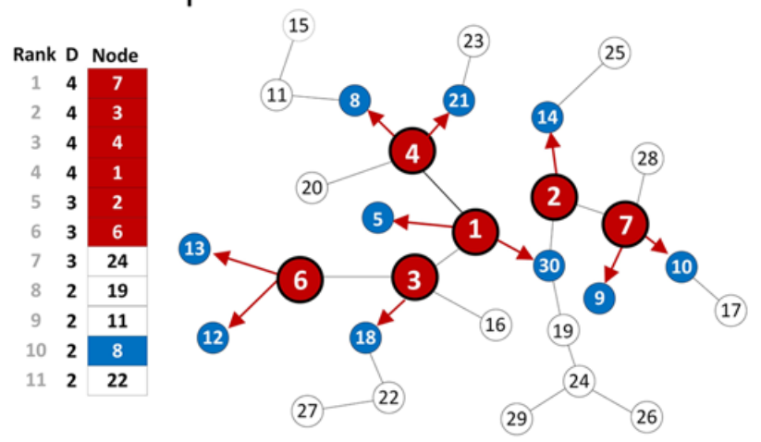
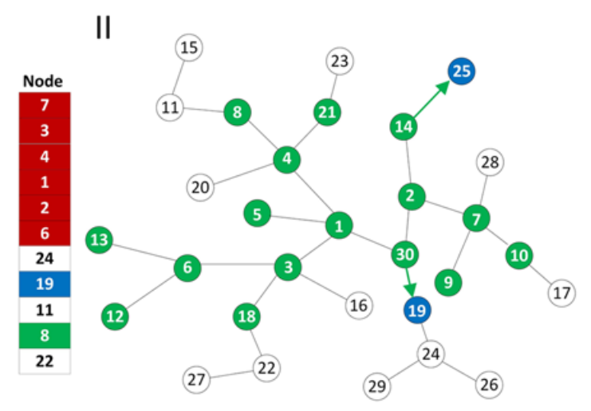
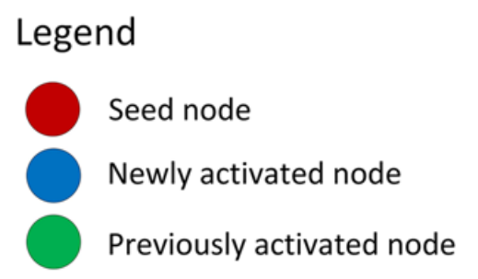
Single Stage Seeding (SN)
Process:
rank nodes
select n top ranked nodes
start difusion

Slide 19
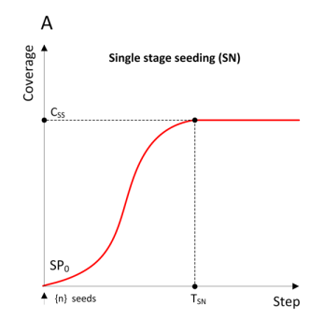
Single Stage Seeding (SN)
# Total Nodes Used | n
# Seeding Stages | 1
Max Coverage | C_SN
# Steps / Time | T_SN

Slide 20
Sequential Seeding (SQ)
Process:
For each seeding stage:
Rank the inactive nodes
Select required number of top ranked nodes
Start diffusion
# Total Nodes Used | n
# Seeding Stages | >= 1
Max Coverage | C_SQ
# Steps / Time | T_SQ

Slide 21
SQ_kPS
Fixed:
# nodes used per stage
Process:
For each seeding stage:
Rank the nodes
Select k top ranked nodes
Start diffusion
Diffusion stops after 1 step
# Total Nodes Used | n
# Seed Used per Stage | k
Max Coverage | C_OPS
# Steps / Time | T_OPS

Slide 22
SQ_1PS
Process:
For each seeding stage:
Rank the nodes
Select 1 top ranked nodes
Start diffusion
# Total Nodes Used | n
# Seed Used per Stage | 1
# Seeding Stage | n
Max Coverage | C_OPS
# Steps / Time | T_OPS

Slide 23
SQ_2PS
Process:
For each seeding stage:
Rank the nodes
Select 2 top ranked nodes
Start diffusion
# Total Nodes Used | n
# Seed Used per Stage | 2
# Seeding Stage | n/2
Max Coverage | C_OPS
# Steps / Time | T_OPS

Slide 24
SQ_kPS
v.s.
SN
C_OPS v.s. C_SN:
Commonly better coverage
T_OPS v.s. T_SN:
Common longer time

Slide 25
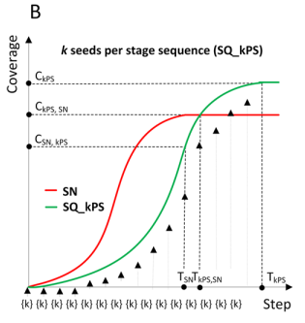
SQ_kPS v.s. SN
C_OPS > C_SN:
Better coverage
T_OPS < T_SN:
Slower speed

Slide 26
SQ_TSN
Fixed:
# seeding stages
= T_TSN
Process:
For each seeding stage:
Rank the nodes
Select n / T_TSN top ranked nodes
Start diffusion
Diffusion stops after 1 step
# Total Nodes Used | n
# Seed Used per Stage | n / T_TSN
# Seeding Stage | T_TSN
Max Coverage | C_TSN
# Steps / Time | T_TSN

Slide 27
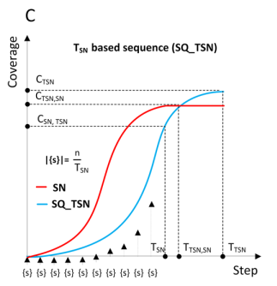
SQ_TSN v.s. SN
C_TSN > C_SN:
Better coverage
T_TSN > T_SN:
Slower speed

Slide 28
SQ_TSN
v.s.
SQ_kPS
v.s.
SN
C_OPS > C_TSN > C_SN
T_OPS > T_TSN > T_SN

Slide 29
Revival Mode
Process:
For each seeding stage:
Rank the nodes
Select required number of top ranked nodes
Start diffusion
Diffusion stops after reach max saturation of current diffusion stage
—— Extends diffusion time for each diffusion stage

Slide 30
SQ_kPS_R
Fixed:
# nodes used per stage
Process:
For each seeding stage:
Rank the nodes
Select k top ranked nodes
Start diffusion
Diffusion stops after reach max saturation
# Total Nodes Used | n
# Seed Used per Stage | k
Max Coverage | C_OPS
# Steps / Time | T_OPS

Slide 31
SQ_TSN_R
Fixed:
# seeding stages
Process:
For each seeding stage:
Rank the nodes
Select n / T_SN top ranked nodes
Start diffusion
Diffusion stops after reach max saturation
# Total Nodes Used | n
# Seed Used per Stage | n / T_SN
# Seeding Stage | T_SN
Max Coverage | C_OPS
# Steps / Time | T_TSN

Slide 32
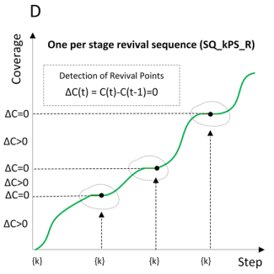
SQ_kPS_R v.s. SN
C_OPS_R > C_SN:
Best coverage
T_OPS_R > T_SN:
Slowest speed

Slide 33
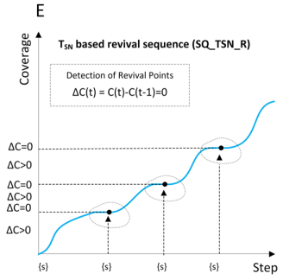
SQ_TSN_R v.s. SN
C_TSN_R > C_SN:
Better coverage
T_TSN_R > T_SN:
Slower speed

Slide 34
Buffer Mode
Process:
For each seeding stage:
Rank the nodes
Select required number of top ranked nodes
Start diffusion
Diffusion stops after 1 step
Rank and select #b nodes
Start diffusion again and until stops
Store # unused nodes in a buffer (b)
Initiate #b inactive nodes again after diffusion stops
—— Guarantee that all of the k nodes are used

Slide 35
SQ_kPS_B
Fixed:
# nodes used per stage
Process:
For each seeding stage:
Rank the nodes
Select k top ranked nodes
Start diffusion
Diffusion stops after 1 step
Rank, select b nodes and start diffusion again
# Total Nodes Used | n
# Seed Used per Stage | k
Max Coverage | C_OPS
# Steps / Time | T_OPS

Slide 36
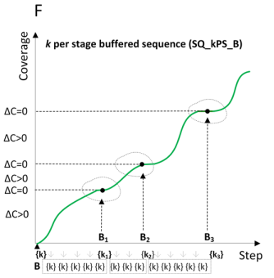
SQ_kPS_B v.s. SN
C_kPS_B > C_SN:
Better coverage
T_kPS_B > T_SN:
Slower speed

Slide 37
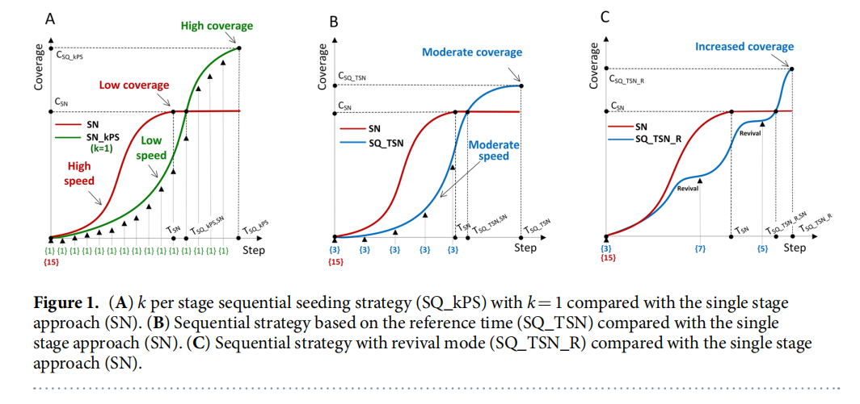
SQ_1PS_R (best coverage)
v.s.
SN
COVERAGE:
#Cases where C_1PS_R > C_SN:
100% cases
Average of
(C_1PS_R-C_SN) / C_SN:
13.1%

Slide 38
DATA
15 Network
5 Propagtion Probablities
5 Seeds Percentage
5 Ranking Methods
—— 15*5*5*5 = 1875 configurations
Notes:
what is application
what it represent

Slide 39
DATA
15 Network
5 Propagtion Probablities
5 Seeds Percentage
5 Ranking Methods

Slide 40
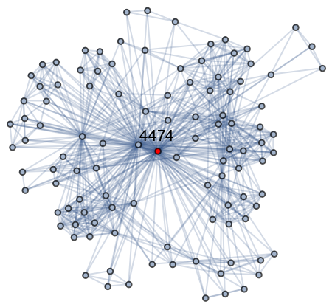
Condensed Matter Collaborations 1999 Network
Total Nodes: 16726
Total Edges: 47594

Slide 41
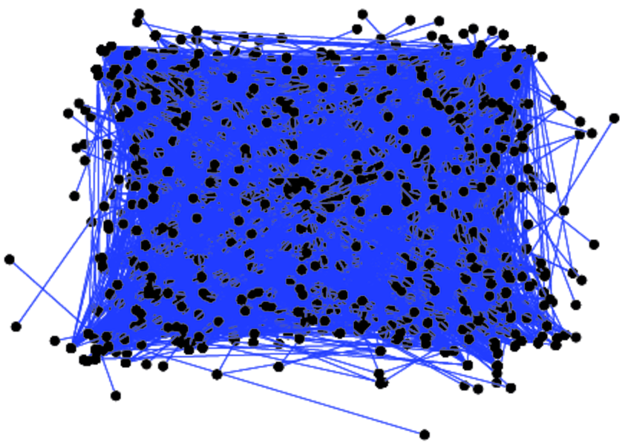
UC Irvine Messages
Total Nodes: 1,899
Total Edges: 59,835
Clustering coefficien: 0.056

Slide 42
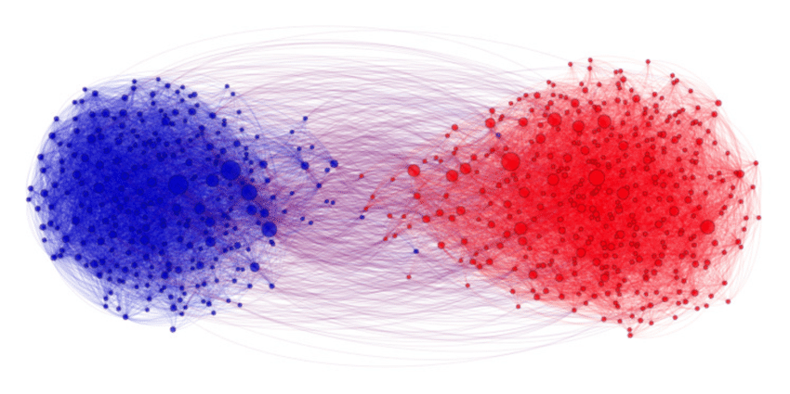
Political Blogs Network (2004)
Total Nodes: 1,490
Total Edges: 19,090

Slide 43
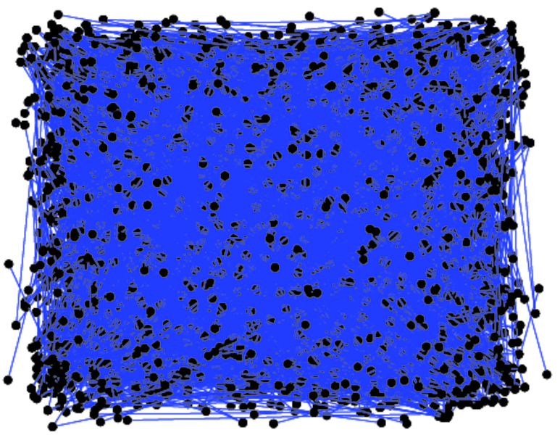
US Power Grid
Total Nodes: 4,941
Total Edges: 6,594

Slide 44
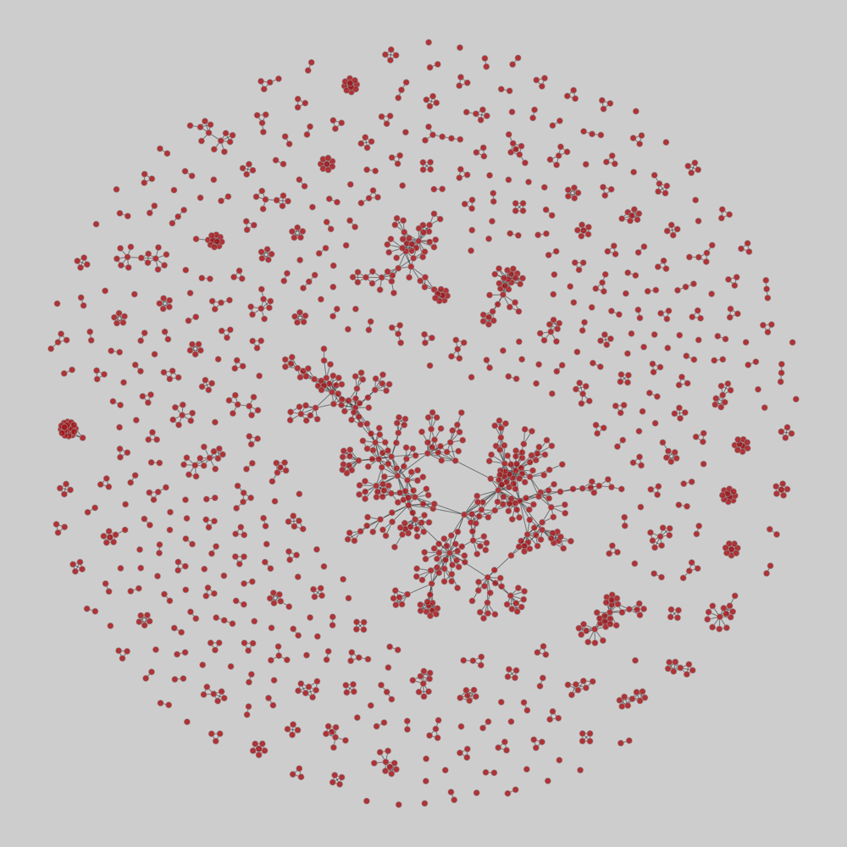
Scholarly Collaboration in Network Science
Total Nodes: 1,589
Total Edges: 2,742

Slide 45
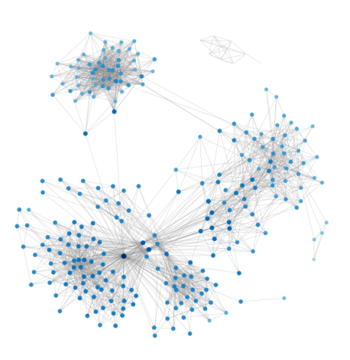
ego-Facebook
Total Nodes: 4,039
Total Edges: 88,234

Slide 46
General Relativity and Quantum Cosmology Collaboration Network
Total Nodes: 5,242
Total Edges: 14,496

Slide 47
DBLP
Total Nodes: 12,591
Total Edges: 49,743

Slide 48
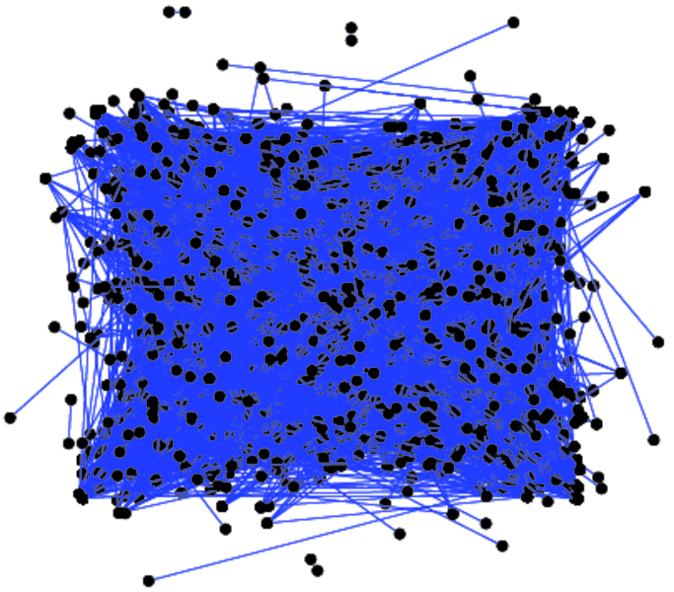
Hamsterster friendships
Total Nodes: 1,858
Total Edges: 12,534
hamsterster.com

Slide 49
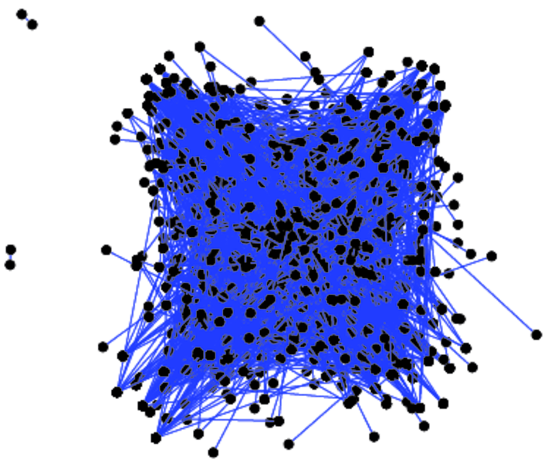
UC Irvine Forum
Total Nodes: 899
Total Edges: 33,720

Slide 50
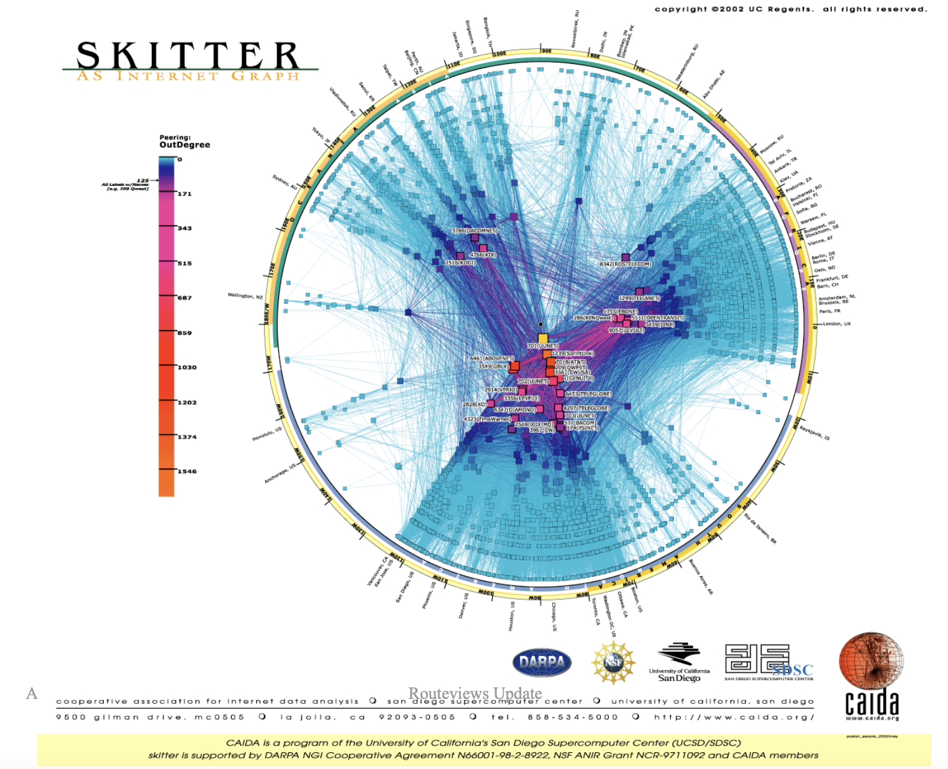
University of Oregon Route Views
Total Nodes: 6,474
Total Edges: 13,895

Slide 51
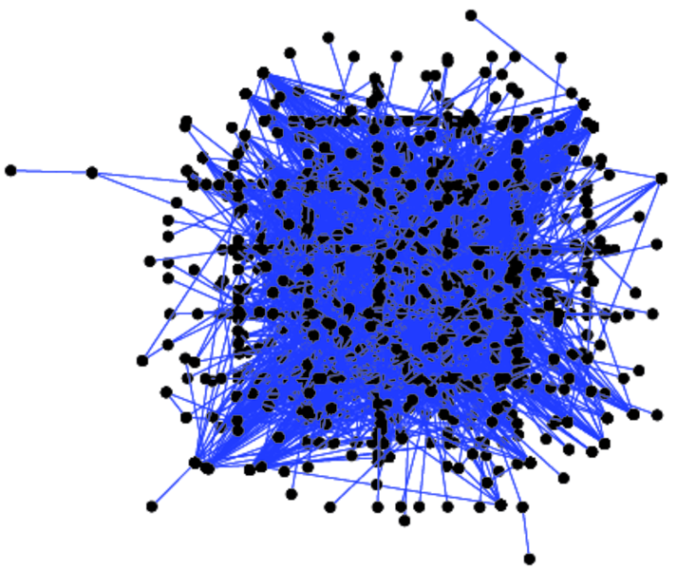
Communication at the University Rovira i Virgili
Total Nodes: 1,133
Total Edges: 5,451

Slide 52
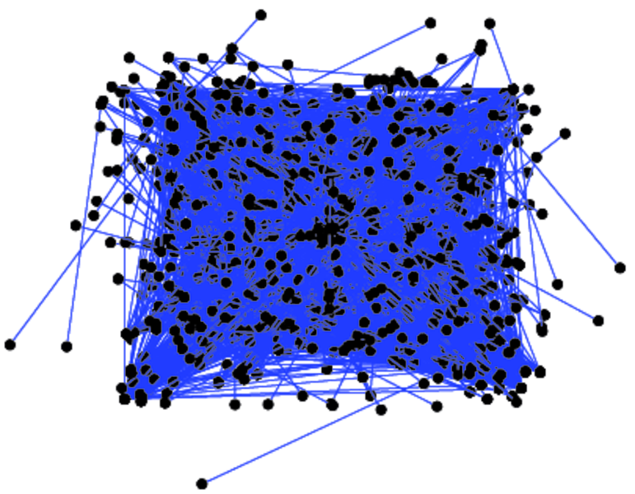
US Airports
Total Nodes: 1,574
Total Edges: 28,236

Slide 53
JUNG and Javax Dependency
Total Nodes: 6,120
Total Edges: 138,706

Slide 54
Reactome Project
Total Nodes: 6,327
Total Edges: 147,547

Slide 55
RESULTS

Slide 56
SQ
v.s.
SN
COVERAGE:
#Cases where C_SQ > C_S:
89.8% cases
Average of
(C_SQ-C_SN) / C_SN:
10.1%
Max of
(C_SQ-C_SN) / C_SN:
50%

Slide 57
SQ
v.s.
SN
TIME:
Average of
T_SQ : T_SN:
5.1 : 1

Slide 58
SQ_1PS_R (best coverage)
v.s.
SN
COVERAGE:
#Cases where C_1PS_R > C_SN:
95.3% cases
(100% cases for configs with same network and same ranking method)
Average of
(C_1PS_R-C_SN) / C_SN:
13.1%

Slide 59
SQ
v.s.
SN
OVERALL:
Higher Coverage
Lower Speed
trade-off between coverage and time

Slide 60
SQ_1PS_R (best coverage)
v.s.
SN

Slide 61
Factors Affecting Performance
Extent to which we avoid selecting the nodes able to be activated through diffusion
Greater gain in:
revival mode
Selecting new nodes with high potential to activate its neighbors
Greater gain in:
low coverage network

Slide 62
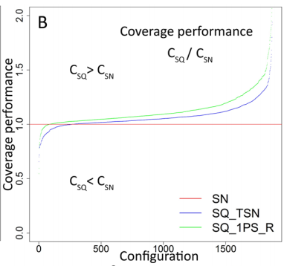
High Coverage
more visible difference
C_SQ always > C_SN
Similar Results
Low Coverage

Slide 63
Factors Affecting Performance
Length of sequence (#nodes per stage)
Shorter sequence gives better results
C_SQ_1PS_R > C_TSN in 90.5% cases

Slide 64
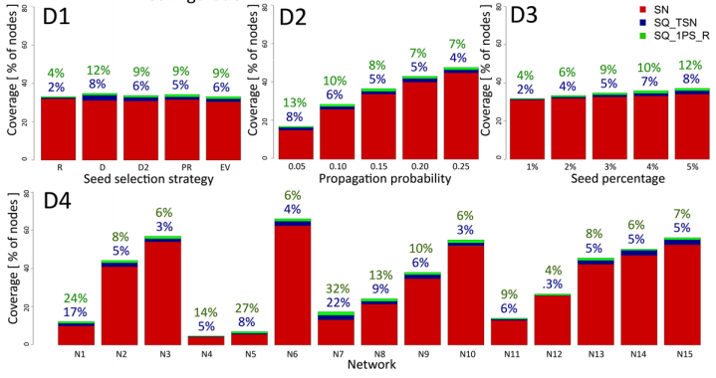
Factors Affecting Performance

Slide 65
EVALUATION
problem definition and methodology
analysis and argument
structure
referencing

Slide 66
FUTURE WORK

